Slide 1
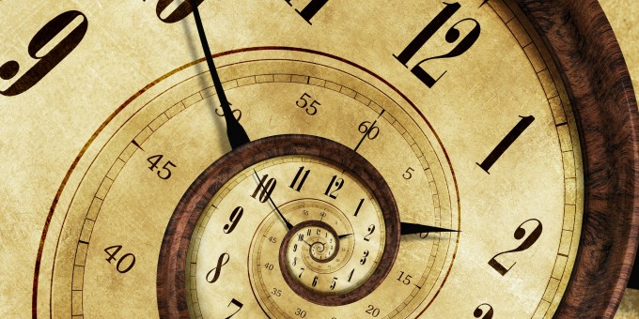

CLOCKS
© Department of Analytical Skills

Slide 2
Table of content
loss or gain in time
mirror image of a clock

Slide 3
GAIN AND LOSS OF TIME IN AN INCORRECT CLOCK:
When the speed of the hands of the clock increases they complete their rotation for a day sooner.
When the hands of the clock move slower than usual, they take more time to complete the rotations for a day.

Slide 4
KEY POINTS
The hands are in the same straight line when they are coincident or opposite to each other
When the two hands are at right angles, they are 15 minute spaces apart

Slide 5
When the hands are in opposite directions, they are 180 degree apart
The hands of the clock form an angle of 0° or 180° − 22 times a day
The hands of the clock form an angle of 1° to 179° − 44 times a day

Slide 6
PRACTICE QUESTIONS

Slide 7
1. How much does a watch gain per day, if its hands coincide every 64 minutes?
32 8/11 min
(b) 36 5/11 min
(c) 90 min
(d) 96 min
Ans: A

Slide 8
2. How many minutes is it until six o’clock if fifty minutes ago it was four times as many minutes past three o’clock?
26 min
(b) 27 min
(c) 30 min
(d) None of these
Ans: A

Slide 9
3. A man who went out between 3 and 4 and returned between 8 and 9, found that the hands of the watch had exactly changed places. When did he return?
14 min past 8
(b) 21 1/3min past 8
(c) 19 2/3 min past 8
(d) 18 6/13 min past 8
Ans: D

Slide 10
4. My watch was 8 minutes behind at 8 p.m. on Sunday but it was 7 minutes ahead of time at 8 p.m. on Wednesday. During this period, at which time has this watch shown the correct time?
Tuesday 10.24 a.m.
(b) Wednesday 9.16 p.m.
(c) Tuesday 10.24 p.m.
(d) Wednesday 9.16 a.m.
Ans: A

Slide 11
5. A friend of mine invented a new clock. It times an entire day in 10 hours, each hour in 100 minutes and each minute in 100 seconds. What normal time is it when it reads 5:41?
12:59:02
(b) 12:59:01
(c) 11:59:02
(d) None of these
Ans: A

Slide 12
6. The minute hand of a clock overtakes the hour hand at intervals of 65 minutes of the correct time. How much a day does the clock gain or lose in minutes?
1440/143
(b) 1444/143
(c) 1400/143
(d) 4440/143
Ans: A

Slide 13
7. Between 11 o'clock and 12 o'clock, how often will the difference between the positions of the minute and hour hands of a clock have an integral number of minutes?
4
(b) 6
(c) 3
(d) 5
Ans: D

Slide 14
8. A clock loses 1% time during the first week and then gains 2% time during the next one week. If the clock was set right at 12 noon on a Sunday, what will be the time shown by the clock exactly after 14 days from the time it was set right?
1 : 40 : 48 p.m.
(b) 1 : 40 : 28 p.m.
(c) 1 : 40 : 46 p.m.
(d) 1 : 40 : 26 p.m.
Ans: A

Slide 15
9. A clock is set right at 8 a.m. The clock gains 10 minutes in 24 hours. What will be the true time when the clock indicates 1 p.m. on the following day?
48 min past 12
(b) 48 min past 11
(c) 45 min past 12
(d) 45 min past 11
Ans: A

Slide 16
10. At what time between 4 and 5 o'clock, will the hands of a watch point in opposite directions?
(a) 54 min past 4
(b) 53 7/11 min past 4
(c) 54 7/11 min past 4
(d) 54 6/11 min past 4
Ans: C

Slide 17
11. A watch which gains 5 seconds in 3 minutes was set right at 7 a.m. In the afternoon of the same day, when the watch indicated quarter past 4 o'clock, the true time is
3:59:35 p.m.
(b) 6 p.m.
(c) 5 p.m.
(d) 7 p.m.
Ans: A

Slide 18
12. At what time between 5.30 and 6 o' clock, will the hands of a clock be at right angles?
43 5/11 min past 5
(b) 43 7/11 min past 5
(c) 5 p.m.
(d) 7 p.m.
Ans: B

Slide 19
13. Find the reflex angle between the hour hand and the minute hand of a clock when the time is 11:25.
192.5 ⁰
(b) 230 ⁰
(c) 45 ⁰
(d) 72 ⁰
Ans: A

Slide 20
14. Three clocks were set to true time. First runs with exact time. Second slows one minute per day. Third gains one minute per day. After how many days will they show the same time?
150 days
(b) 550 days
(c) 1440 days
(d) 2220 days
Ans: C

Slide 21
15. A clock showing 6 o'clock takes 30 secs to strike 6 times. How long will it take to strike 12 at midnight?
45 secs
(b) 40 secs
(c) 66 secs
(d) 60 secs
Ans: C

Slide 22
16. Light glows for every 12 seconds. How many times did it glow between 2:58:59 a.m. and 4:10:23 a.m.?
384
(b) 357
(c) 383
(d) 380
Ans: A

Slide 23
17. Three cuckoo clocks are such that the cuckoos chime after every 10 minutes, 20 minutes and 35 minutes respectively. If the 3 clocks chime simultaneously at 2pm, at what time will they chime together again?
3 p.m.
(b) 1:40 p.m.
(c) 3.20 p.m.
(d) 4:20 p.m.
Ans: D

Slide 24
18. A certain clock marks every hour by striking a number of times equal to the hour and the time required for a stroke is exactly equal to the time interval between the two consecutive strokes. At 6.00, the time lapse between the beginning of the first stroke and the end of the last stroke is 22 seconds. At 12.00, how many seconds do elapse between the beginning of the first stroke and the end of the last stroke?
44
(b) 43
(c) 46
(d) 54
Ans: C

Slide 25
19. The quarter of the time from midnight to present time added to the half of the time from the present to midnight gives the present time. What is the present time?
36 min past 9
(b) 12 min past 9
(c) 36 min past 8
(d) 12 min past 8
Ans: A

